Slide 1
JavaScript
Language Fundamentals

Slide 2
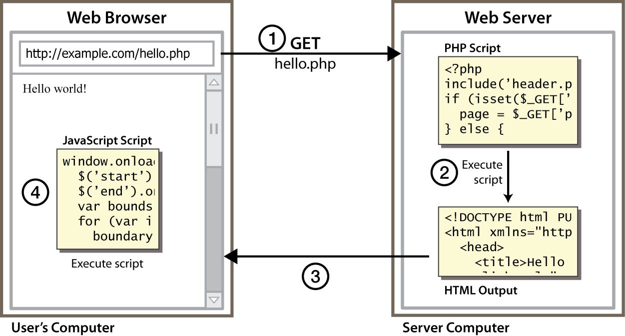
Client Side Scripting
Notes:
client-side script: code runs in browser after page is sent back from server
often this code manipulates the page or responds to user actions

Slide 3
Why use client-side programming?
Server scripting languages(PHP) already allows us to create dynamic web pages. Why also use client-side scripting?
client-side scripting (JavaScript) benefits:
usability: can modify a page without having to post back to the server (faster UI)
efficiency: can make small, quick changes to page without waiting for server
event-driven: can respond to user actions like clicks and key presses

Slide 4
Server-side programming?
server-side programming (PHP) benefits:
security: has access to server's private data; client can't see source code
compatibility: not subject to browser compatibility issues
power: can write files, open connections to servers, connect to databases, ...

Slide 5
About JavaScript
JavaScript is not Java, or even related to Java
The original name for JavaScript was “LiveScript”
The name was changed when Java became popular
Statements in JavaScript resemble statements in Java, because both languages borrowed heavily from the C language
JavaScript should be fairly easy for Java programmers to learn
However, JavaScript is a complete, full-featured, complex language
JavaScript is seldom used to write complete “programs”
Instead, small bits of JavaScript are used to add functionality to HTML pages
JavaScript is often used in conjunction with HTML “forms”
JavaScript is reasonably platform-independent

Slide 6
Javascript everywhere
Popular programming language
Can be used in any application in any platform
Web Application, Mobile Application Machine learning etc
JS Engine is available in most of the browsers

Slide 7
Hello world program
Program → machine code
prg1.js – in any editor
Console.log(“Hello World”);
Execute ?

Slide 8

Execution
In browser console (without html and css) – JS engine
Inside html JS engine
Command prompt (without browser)
Need node js (can run javascript on OS)
Runtime environment
Download
Check node - - version
To run- node f1.js
To quit – CTRLC twice
Notes:
In browser console – shift enter for writing many lines

Slide 9
Variables – let
let data = 10 create a variable using let
let name = “XYZ”
Constants
Const data=100
What is var ?

Slide 10
var
Variables declared with the var keyword can NOT have block scope.
Variables declared inside a { } block can be accessed from outside the block.
Redeclaring a variable using the var keyword can impose problems.
Redeclaring a variable inside a block will also redeclare the variable outside the block:

Slide 11
Redeclaring a variable using the let keyword can solve this problem.
Redeclaring a variable inside a block will not redeclare the variable outside the block:
Block scoped
Variables defined with let can not be redeclared.

Slide 12
Egs (redeclaration and scope)
let x = "John Doe"; let x = 0;
let x = 10; // Here x is 10 { let x = 2; // Here x is 2 } // Here x is 10
var x = "John Doe"; var x = 0;
var x = 10; // Here x is 10 { var x = 2; // Here x is 2 } // Here x is 2

Slide 13


let x=10
{
let x="hello"
console.log(x)
}
console.log(x)
var x=10
{
var x="hello"
console.log(x)
}
Console.log(x)

Slide 14
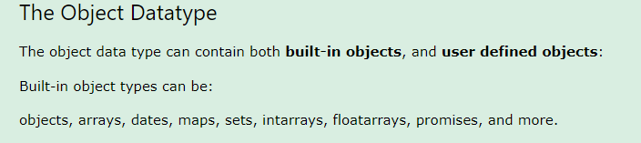
Data Types
Primitive – Number(float), String, Boolean, Null, Undefined, Symbol
Object – not a primitive type

Slide 15



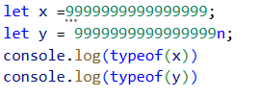

Number
typeof X
Underscores for long numbers(instead of comma)
Infinity, -infinity
MAX_VALUE
Bigint – add n at the end of the number
Let x= bigint(123232323423552)
let x = 9999999999999999; let y = 9999999999999999n;

Slide 16
Strings
Single quote, double quote
Escape sequences
Let s= ‘Sdnfksdnfjksndk \‘sscdfbsdhbfsbfd’

Slide 17
boolean
True
False
let x=Boolean(1 > 9)
console.log(x)

Slide 18
undefined,Empty
undefined – undefined datatype
let car;
console.log(car)
Empty
let car = "";
console.log(car)
console.log(typeof car)

Slide 19

Type Conversion
Convert one datatype to another
Explicit Conversion
Let x= number(“100”)

Slide 20
Converting Strings to Numbers
Converting Numbers to Strings
Converting Dates to Numbers
Converting Numbers to Dates
Converting Booleans to Numbers
Converting Numbers to Booleans

Slide 21
Converting Strings to Numbers
The global method Number() converts a variable (or a value) into a number.
A numeric string (like "3.14") converts to a number (like 3.14).
An empty string (like "") converts to 0.
Number("3.14") Number(Math.PI) Number(" ") Number("")
A non numeric string (like "John") converts to NaN (Not a Number).
Number(“amrita”)

Slide 22


Converting Numbers to Strings
The global method String() can convert numbers to strings.
It can be used on any type of numbers, literals, variables, or expressions:
String(x)
String(123) String(100 + 23)

Slide 23
Converting Dates to Strings
console.log(String(Date()))
Output: Mon Aug 19 2024 14:44:35 GMT+0530 (India Standard Time)

Slide 24
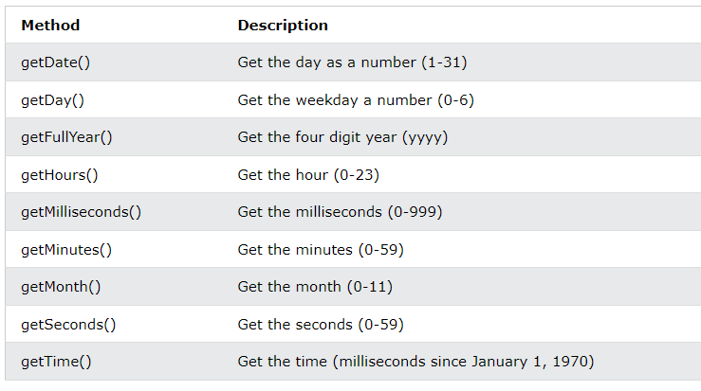

Slide 25
Converting Booleans to Numbers
The global method Number() can also convert booleans to numbers.
let x= Number(false) // returns 0
let y=Number(true)
console.log(x)
console.log(y)

Slide 26
Converting Booleans to Strings
The global method String() can convert booleans to strings.
String(false) // returns "false"
String(true) // returns "true"

Slide 27
Automatic Type Conversion
When JavaScript tries to operate on a "wrong" data type, it will try to convert the value to a "right" type.
5 + null // returns 5 because null is converted to 0 "5" + null // returns "5null" because null is converted to "null" "5" + 2 // returns "52" because 2 is converted to "2" "5" - 2 // returns 3 because "5" is converted to 5 "5" * "2" // returns 10 because "5" and "2" are converted to 5 and 2

Slide 28
Type Coercion
Operating with two different datatypes
Decide the operation
2 +” sample” -> string operation
2- sample -> number operation
Any type to Boolean
truthy values- all values are converted as true
except undefined, null, Nan, 0, “ “, false – falsy values
true + true =?
Let x = Boolean(“”)

Slide 29
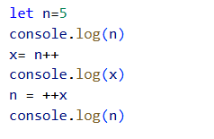
Operators
Arithmetic Operators - +, -, *, /, %, **
Shorthand operators +=, -= …
preincrement
postincrement
Eg n=5
x= n++ x=5, n=6
n = ++x x=6 n=6
Value of n and x after the above statements?

Slide 30
Operators - Arithmetic
Arithmetic Operators - +, -, *, /, %
Shorthand operators +=, -= …
preincrement
postincrement
Eg n=5
x= n++
n = ++x
Value of n and x after the above statements?
x= 6 n=6

Slide 31
Relational Operators
<, >, <=, >=, ==, ===(data and type)
Output is a Boolean value
Compare
number and number
String and string
String and number

Slide 32
Other operators
Logical operators: && || ! (&& and || are short-circuit operators)
Bitwise operators: & | ^ ~ << >> >>>
Assignment operators: += -= *= /= %= <<= >>= >>>= &= ^= |=
String operator: +
The conditional operator: condition ? value_if_true : value_if_false
Additional operators: new typeof void delete

Slide 33
Comments
Comments are as in C or Java:
Between // and the end of the line
Between /* and */
Java’s javadoc comments, /** ... */, are treated just the same as /* ... */ comments; they have no special meaning in JavaScript

Slide 34
for loop (same as Java)- output?
var sum = 0;
for (var i = 0; i < 100; i++) {
sum = sum + i;
} JS
var s1 = "hello";
var s2 = "";
for (var i = 0; i < s1.length; i++) {
s2 += s1.charAt(i) + s1.charAt(i);
}

Slide 35
for loop (same as Java)
var sum = 0;
for (var i = 0; i < 100; i++) {
sum = sum + i;
} JS
var s1 = "hello";
var s2 = "";
for (var i = 0; i < s1.length; i++) {
s2 += s1.charAt(i) + s1.charAt(i);
}
// s2 stores "hheelllloo"

Slide 36
while loops (same as Java)
while (condition) {
statements;
}
do {
statements;
} while (condition);
break and continue keywords also behave as in Java

Slide 37
Array – different ways to create an array
You can use an array literal: var colors = ["red", "green", "blue"];
You can use new Array() to create an empty array:
var colors = new Array();
You can add elements to the array later: colors[0] = "red"; colors[2] = "blue"; colors[1]="green";
You can use new Array(n) with a single numeric argument to create an array of that size
var colors = new Array(3);
You can use new Array(…) with two or more arguments to create an array containing those values:
var colors = new Array("red","green", "blue");

Slide 38
Arrays
var name = []; // empty array
var name = [value, value, ..., value]; // pre-filled
name[index] = value; // store element JS
var ducks = ["Huey", "Dewey", "Louie"];
var stooges = []; // stooges.length is 0
stooges[0] = "Larry"; // stooges.length is 1
stooges[1] = "Moe"; // stooges.length is 2
stooges[4] = "Curly"; // stooges.length is 5
stooges[4] = "Shemp"; // stooges.length is 5
Notes:
two ways to initialize an array
length property (grows as needed when elements are added)

Slide 39
Array methods
var a = ["Stef", "Jason"]; // Stef, Jason
a.push("Brian"); // Stef, Jason, Brian
a.unshift("Kelly"); // Kelly, Stef, Jason, Brian
a.pop(); // Kelly, Stef, Jason
a.shift(); // Stef, Jason
a.sort(); // Jason, Stef
array serves as many data structures: list, queue, stack, ...
methods: concat, join, pop, push, reverse, shift, slice, sort, splice, toString, unshift
push and pop add/remove from back
unshift and shift add/remove from front
shift and pop return the element that is removed
slice returns a piece of the array but it doesn’t affect the original array. splice changes the original array by removing, replacing, or adding values and returns the affected values.

Slide 40
String type
var s = "Connie Client";
var fName = s.substring(0, s.indexOf(" ")); // "Connie"
var len = s.length; // 13
var s2 = 'Melvin Merchant';
methods: charAt, charCodeAt, fromCharCode, indexOf, lastIndexOf, replace, split, substring, toLowerCase, toUpperCase
charAt returns a one-letter String (there is no char type)
length property (not a method as in Java)
let text = "Hello World!";
let result = text.toUpperCase();
console.log(result)

Slide 41
let text = "Hello planet earth, you are a great planet."; let result=text.lastIndexOf("planet");
let text = "Visit Tesla!"; let result = text.replace(“Tesla", “Amrita");

Slide 42
More about String
escape sequences behave as in Java: \' \" \& \n \t \\
converting between numbers and Strings:
var count = 10;
var s1 = "" + count; // "10"
var s2 = count + " bananas, ah ah ah!"; // "10 bananas, ah ah ah!"
var n1 = parseInt("42 is the answer"); // 42
var n2 = parseFloat("booyah"); // NaN
accessing the letters of a String:
var firstLetter = s[0]; // fails in IE
var firstLetter = s.charAt(0); // does work in IE
var lastLetter = s.charAt(s.length - 1);

Slide 43
Splitting strings: split and join
var s = "the quick brown fox";
var a = s.split(" "); // ["the", "quick", "brown", "fox"]
a.reverse(); // ["fox", "brown", "quick", "the"]
s = a.join("!"); // "fox!brown!quick!the"
split breaks apart a string into an array using a delimiter
can also be used with regular expressions
join merges an array into a single string, placing a delimiter between them

Slide 44
Arrays
var cars = [“Audi", “Benz", “Jaguar"];
Console.log(cars[0])
In JavaScript, arrays use numbered indexes.

Slide 45
1.Write a JavaScript program that accepts a number as input and inserts dashes (-) between each even and odd number combination.
For example, if you accept 025478 the output should be 02-54-78.
2.Write a JavaScript program to find a pair of elements (indices of the two numbers) in a given array whose difference equals a specific target number.
Input: numbers= [10,20,10,40,50,60,70], target=50 Output: [5, 0] [5, 2] [6,1]

Slide 46
npm install prompt-sync
const prompt = require("prompt-sync")();
let a = prompt("enter a number: ")
console.log(a)

Slide 47
Addition of 2 numbers
const prompt = require("prompt-sync")();
let a = Number(prompt("Enter first number:"));
let b = Number(prompt("Enter second number:"));
let sum = a + b;
console.log("Sum is: " + sum);

Slide 48
JAVASCRIPT programs
1.to check whether number is even or odd
2. Reverse a input string
3.Check whether a string is palindrome or not
4.Find largest number in an array
5.Sum of all elements in an array
6.Reverse an array without using reverse function

Slide 49
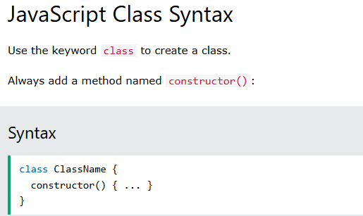
JavaScript Classes are templates for JavaScript Objects.

Slide 50
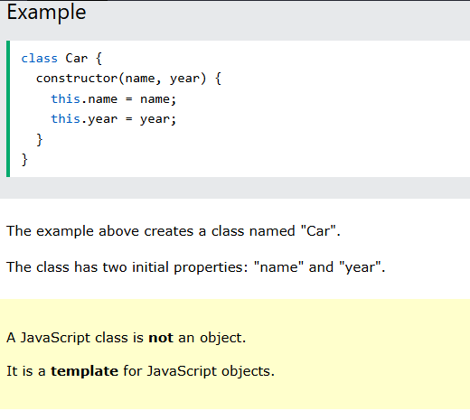
this is a special keyword in JavaScript that refers to the object that is currently using the code.

Slide 51
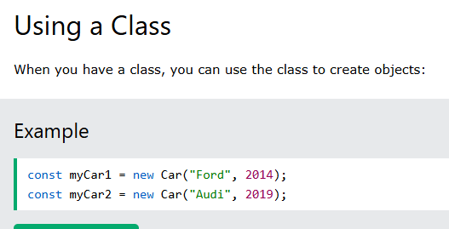

Slide 52
class Car {
constructor(name, year) {
this.name = name;
this.year = year;
}
}
const myCar1 = new Car("Ford", 2014);
const myCar2 = new Car("Audi", 2019);
console.log(myCar1.name)
//Initializing object property

Slide 53
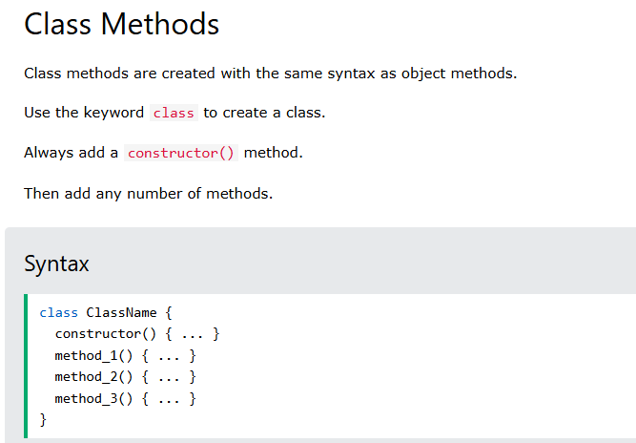

Slide 54
Class methods program
class Person{
constructor(name,year)
{
this.name=name;
this.year=year;
}
age(){
const date = new Date();
return date.getFullYear() - this.year;
}
}
const car=new Person('glanza',2024)
console.log("My car is " + car.age() + " years old.");

Slide 55
Objects – not primitive ones
To represent real-world entity in the virtual world.
let student = { } // empty object
let student = {
key1 : value1,
key2: value2 } //like dictionary
}
const person = {firstName:"John", lastName:"Doe", age:50, eyeColor:"blue"};
Access all or particular property
Student or student.key1 or student[‘key1’]

Slide 56
Objects(Other way of creating an object)
const car={name:"glanza",year:2024};
const car1={name:"kiger",year:2022};
console.log(car.name)
console.log("I purchased my second car in the year",car1.year)

Slide 57
Arrays and objects
Arrays are objects – special objects
In JavaScript, objects use named indexes whereas Arrays use numbered indexes.
car = { myCar: "Saturn", 7: "Mazda" }
car[7] is the same as car.7
car.myCar is the same as car["myCar"]
If you know the name of a property, you can use dot notation: car.myCar
If you don’t know the name of a property, but you have it in a variable (or can compute it), you must use array notation: car.["my" + "Car"]

Slide 58
console.log(student.name)
console.log(student[‘name’]);
prop1= ‘name’
console.log(student[prop1]) // cannot use dot operator if it is variable
Add functions

Slide 59
Complex objects
Object within an object
let boxOfStuff = {
book: "Object-Oriented JavaScript", smallerBox:
{ stuff: ["pencils", "pens"],
smallestBox: { stuff: ["paper clips", "thumbtacks"] }
}
};
console.log(boxOfStuff.smallerBox.smallestBox.stuff)

Slide 60
console.log(boxOfStuff.smallerBox.smallestBox.stuff);
// Output: ["paper clips", "thumbtacks"]
If paperclips to be accessed?

Slide 61
console.log(boxOfStuff.smallerBox.smallestBox.stuff);
// Output: ["paper clips", "thumbtacks"]
If paperclips to be accessed?
console.log(boxOfStuff.smallerBox.smallestBox.stuff[0]);
Or
console.log(boxOfStuff['smallerBox']['smallestBox']['stuff'][0]);
// Output: "paper clips"

Slide 62
Complex Objects
Examples( with function, variable)
car = {myCar: "Saturn", 7: "Mazda", getCar: CarTypes("Honda"), special: Sales}
The fields are myCar, getCar, 7 (this is a legal field name) , and special
"Saturn" and "Mazda" are Strings
CarTypes is a function call
Sales is a variable you defined earlier
Example use: document.write("I own a " + car.myCar);

Slide 63
Three ways to create an object
You can use an object literal:
var course = { number: "CIT597", teacher="Dr. Dave" }
You can use new to create a “blank” object, and add fields to it later:
var course = new Object(); course.number = "CIT597"; course.teacher = "Dr. Dave";
You can write and use a constructor:
function Course(n, t) { // best placed in <head> this.number = n; this.teacher = t; }
var course = new Course("CIT597", "Dr. Dave");

Slide 64
Write a javascript program to print key names in javascript objects

Slide 65
console.log(Object.keys(Course));
Object.values(Course) ?

Slide 66
The for…in statement to Iterate on object’s properties
You can loop through all the properties of an object with ‘for’ (variable in object) statement;
Example: for (var prop in course) { console.log(prop + ": " + course[prop]); }
for (let key in student)
{ console.log(key, student[key]) // not dot operator

Slide 67
const person = {fname:"John", lname:"Doe", age:25};
let text = "";
for (let x in person) {
text += person[x];
}
console.log(text)

Slide 68
const numbers = [45, 4, 9, 16, 25];
let txt = "";
for (let x in numbers) {
txt += numbers[x];
}
console.log(txt)

Slide 69
The with statement
The with keyword is used as a kind of shorthand for referencing
an object's properties or methods.
The object specified as an argument to ‘with’ becomes the default
object for the duration of the block that follows.
The properties and methods for the object can be used
without naming the object.
Syntax
The syntax for “with” object is as follows −
with (object){
properties used without the object name and dot
}

Slide 70
eg
function addPrice(amount){
with(this){
price = amount;
}
}
function book(title, author){
this.title = title;
this.author = author;
this.price = 0;
this.addPrice = addPrice; // Assign that method as property.
}
mybook = new book("FSD", "Chris");
mybook.addPrice(1000);
Book1=new book("TOC","Christ");
Book1.addPrice(500);
console.log(mybook)
console.log(Book1)

Slide 71
Create a simplified online bookstore inventory management system. The system needs to handle book information, manage inventory, and provide a way to search for books. Create a JavaScript program that represents this scenario.
Create a book or array of book objects…
For loop for display
For loop for searching
Update a particular books quantity

Slide 72
let books = [ { title: "The Great Gatsby", author: "F. Scott Fitzgerald", genre: "Classic", quantity: 10 }, { title: "To Kill a Mockingbird", author: "Harper Lee", genre: "Fiction", quantity: 15 }, { title: "1984", author: "George Orwell", genre: "Dystopian", quantity: 8 }, // Add more books as needed ];

Slide 73
Now use html command to include the javascript output in html
Use alert
or
document.write("<h1>Hello World!</h1>") ;
or
Document.getelementbyID(“ id”).innerHTML =Course[0]

Slide 74
Functions
Reuse the set of statements
Dividing the tasks into small tasks.
function message()
{console.log(“Welcome”); }
message()
message()

Slide 75

User input in nodejs

Slide 76
Compare 2 no’s(Run-time input)
const readline = require("readline-sync");
function max(x,y)
{ if (x>y)
return x;
else
return y;
}
let x1 = Number(readline.question("Enter x value:"));
let y1 = Number(readline.question("enter y value:"));
console.log("the biggest number is",max(x1,y1));

Slide 77
More about Functions
Functions are objects with method called “( )”
A property of an object may be a function (=method)
function max(x,y) { if (x>y) return x; else return y;};
max.description = “return the maximum of two arguments”;
Local declarations may appear in function body
Call can supply any number of arguments
functionname.length : # of arguments in definition
functionname.arguments.length : # arguments in call
Basic types are passed by value, objects by reference
“Anonymous” functions
(function (x,y) {return x+y}) (2,3);

Slide 78
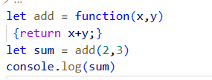
Anonymous functions:In JavaScript, an anonymous function is a function without a name.

Slide 79
Arrow functions
let add = function(x,y)
{return x+y;}
let sum = add(2,3)
let result = sum(4,5);

Slide 80
Arrow functions
let add =(x,y) => {return x+y;}
let sum = add(2,3)
Console.log(sum)
It uses the => syntax and is often used for anonymous functions.

Slide 81
Arrow functions
let add = (x,y) => return x+y; // no need for braces if only one statement
let sum = add(2,3)
Console.log(sum)
let myFunction=(a,b)=>a * b;
let mul=myFunction(2,3);
console.log(mul)
//similar to lambda functions in some other programming languages, ...
// improves readability
// good for simple one-line actions

Slide 82
Functions with parameters
function message(name)
{ console.log(“Welcome”+name);}
message(“XYZ”);
function message(name)
{ return(“Welcome”+name)}
Msg = message(“XYZ”);
console.log(Msg)

Slide 83
Objects with functions
const person = { firstName: "John", lastName: "Doe", id: 5566, fullName: function() { return this.firstName + " " + this.lastName; } };
// can use getter or setter like python

Slide 84
Object and constructor
Use a function to construct an object
function car(make, model, year) {
this.make = make;
this.model = model;
this.year = year; } - cannot add more properties
Objects with “prototype” helps to add more properties.
var c = new car(“Ford”,”Taurus”,1988);
car.prototype.print = function () {
return this.year + “ “ + this.make + “ “ + this.model;}
c.print();

Slide 85
Then what are classes in Javascript?
.
You can also use the class syntax instead of the function syntax to define a constructor function
JavaScript Classes are templates for JavaScript Objects.
class ClassName { constructor() { ... } // add attributes
method_1() { ... } method_2() { ... } method_3() { ... } }

Slide 86
example
object
Class
class Person {
constructor(name, age) {
this.name = name;
this.age = age;
}
sayHello() {
console.log(`Hello, my name is ${this.name} and I'm ${this.age} years old.`);
}
}
const john = new Person('John', 30);
john.sayHello();
let person = {
name: 'John',
age: 30,
sayHello: function() {
console.log('Hello, my name is ' + this.name + I’m + this.age + );
}
};

Slide 87
Objects can also be created using the Object.create() method. This method can be very useful, because it allows you to choose the prototype object for the object you want to create, without having to define a constructor function.

Slide 88
Classes Vs Objects in JS
Use a class when:
You need to create multiple objects with the same structure and behavior.
You want to use inheritance to create a class hierarchy and reuse code.
You want to use polymorphism to treat objects of different classes as if they were the same type.
You want to encapsulate data and behavior in a single unit.
Use an object when:
You need a single entity with specific state and behavior.
You don’t need to create multiple objects with the same structure and behavior.
You don’t need to use inheritance or polymorphism.
You want a simple way to store and manipulate data.

Slide 89
Try it
Define a class named Account with a constructor that initializes properties such as accountNumber, accountHolder, and balance.
Include methods within the class:
displayAccountInfo: Display the account details (account number, account holder, balance).
deposit: Accept an amount and add it to the account balance.
withdraw: Accept an amount and subtract it from the account balance, ensuring sufficient funds.
Create two instances of the Account class, representing different bank accounts.
Call the displayAccountInfo method for each account to show their initial details.
Perform a deposit operation on one account and a withdrawal operation on the others
Call the displayAccountInfo method again for each account to show their updated details.
Your JavaScript program should demonstrate the use of classes, objects, and functions to model a basic banking system. Make sure to handle scenarios where there might be insufficient funds during a withdrawal.

Slide 90
Javascript in webpages

Slide 91
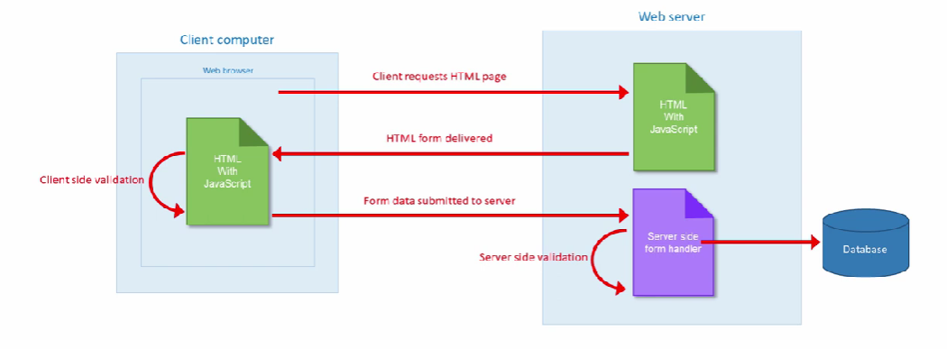
Web page request

Slide 92
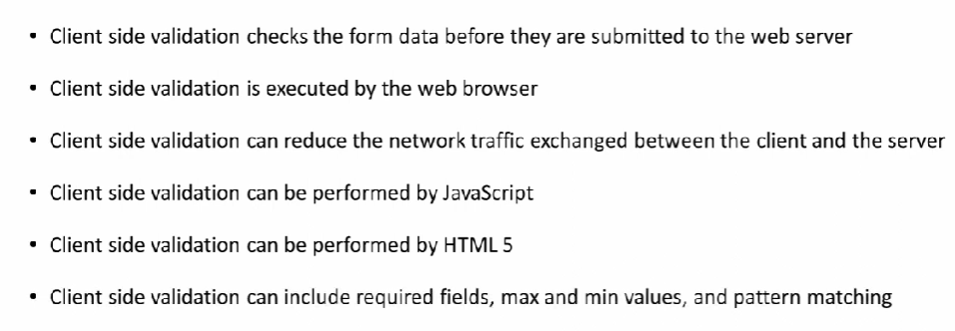
Client side validation

Slide 93
Client Side Validation
Done when the user input is validated by the browser before it is sent to the server,
Using HTML attributes, JavaScript, or other scripting languages.
Advantages
provides instant feedback to the user without reloading the page,
reducing server load and bandwidth, and
improving the user interface and usability.
Drawbacks-
bypassed by disabling or manipulating the browser settings or scripts,
being inconsistent across different browsers, devices, and platforms, and being complex and time-consuming to implement and maintain.

Slide 94
Server Side Validation
Is when the user input is validated by the server after it is received from the browser, using languages such as PHP or ASP.
Provides a more reliable and secure validation, as it can prevent malicious or invalid data from entering the database or affecting the server functionality.
Provides a more consistent and compatible validation, as it can handle different browsers, devices, and platforms, and apply the same rules and logic.
provides a more flexible and dynamic validation, as it can access the database or other resources, and perform more complex or conditional validations.
However, server-side validation can also cause a delay or lag in the user feedback, increase the server load and bandwidth, and degrade the user interface and usability.

Slide 95
When and where to use
Combining client-side and server-side validation is the best practice for form validation, as it provides a balance between the advantages and disadvantages of each technique.
Generally, client-side validation should be used for basic and simple validations, such as required fields, format, and range,
while server-side validation should be used for advanced and complex validations, such as uniqueness, existence, and logic.
Additionally, client-side validation can provide immediate and interactive feedback to the user, and improve the user experience and interface, while server-side validation can provide final and authoritative validation, and ensure data integrity and security.
By following these guidelines, you can create a more effective and efficient form validation for your data entry tasks.

Slide 96
Using JavaScript in html document
JavaScript code is included within <script> tags:
<script type="text/javascript"> document.write("<h1>Hello World!</h1>") ; </script>
Notes:
The type attribute is to allow you to use other scripting languages (but JavaScript is the default)
This simple code does the same thing as just putting <h1>Hello World!</h1> in the same place in the HTML document
The semicolon at the end of the JavaScript statement is optional
You need semicolons if you put two or more statements on the same line
It’s probably a good idea to keep using semicolons

Slide 97
Where to put JavaScript
JavaScript can be put in the <head> or in the <body> of an HTML document
JavaScript functions should be defined in the <head>
This ensures that the function is loaded before it is needed
JavaScript in the <body> will be executed as the page loads
JavaScript can be put in a separate .js file
<script src="myJavaScriptFile.js"></script>
Put this HTML wherever you would put the actual JavaScript code
An external .js file lets you use the same JavaScript on multiple HTML pages
The external .js file cannot itself contain a <script> tag
JavaScript can be put in HTML form object, such as a button
This JavaScript will be executed when the form object is used

Slide 98
How to set up client side validation
On the client side, validation can be done in two ways:
Using HTML5 functionality
Using JavaScript

Slide 99
Using HTML for client-side validation
Making fields required using “required”
Constraining the length of data:
minlength, maxlength: for text data
min and max for the min and max value of num type
Restricting the type of data using type:
<input type="email" name="multiple>
Specifying data patterns using pattern:
specifies a regex pattern that the entered form data needs to match

Slide 100
HTML- validation
<form>
<label for="firstname"> First Name: </label>
<input type="text" name="firstname" id="firstname" required maxlength="45">
<label for="lastname"> Last Name: </label>
<input type="text" name="lastname" id="lastname" required maxlength="45">
<button>Submit</button>
</form>

Slide 101
Using Regexp for validation
A regular expression (regexp) is a pattern that can be used to match character combinations in text strings, so regexps are ideal for form validation and serve a variety of other uses in JavaScript.

Slide 102
A simple example using reg expr
<html lang="en">
<head>
<title>Simple example of JS in html</title>
<script>
function welcome(name)
{alert("welcome "+name);}
</script>
</head>
<body>
<form name="f1" onsubmit="welcome(document.getElementById('fname').value)">
<label for="fname"> Name:</label>
<input type= "text" id = fname pattern="[A-Z] [a-z]+” title="start with caps" required/>
CLICK the button for a welcome message
<input type="submit">
</form>
</body>
</html>>

Slide 103
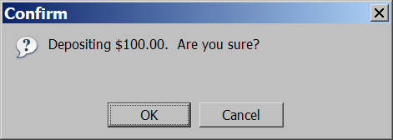
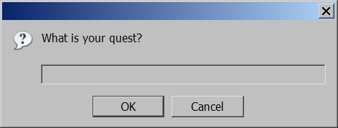
Popup boxes
alert("message"); // message
confirm("message"); // returns true or false
prompt("message"); // returns user input string JS

Slide 104
An example for validation using javascript
function validateUsername() {
var username = document.getElementById("username").value;
var usernameError = document.getElementById("usernameError");
if (username.trim() === "") {
usernameError.textContent = "Username cannot be empty.";
}
else {
for (var i = 0; i < username.length; i++)
{ var char = username[i];
if (!((char >= 'a' && char <= 'z') || (char >= 'A' && char <= 'Z') || (char >= '0' && char <= '9’)))
{ usernameError.textContent = "Invalid character in the username. Use only letters and numbers."; return;
}
}

Slide 105
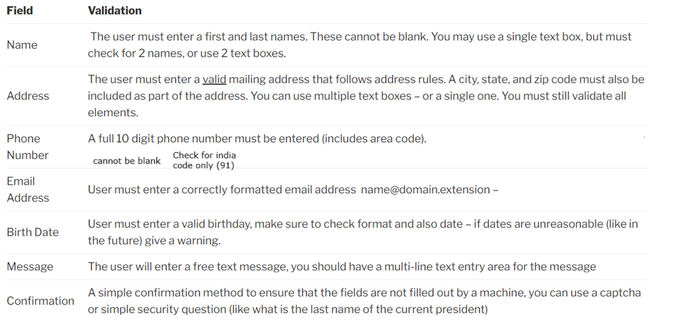
Javascript Assignment 5.1, 5.2, 5.3 – Check the ppt for clear details
Modify the JS welcome() function to check fname to have the first letter as a Capital letter followed by small case letters(No numbers or other characters)followed by a space and capital letter and then small case letters
Use .js file to write the welcome function.
Try the same with pattern matching in html
You are going to create an input form using HTML5 and Javascript. This input form will not submit any database to the server (you learn to do this in COP4834). It will validate and collect information from the user and go to a confirm page that displays the information entered and allows the user to confirm that the information is correct. Below are all the input form fields and the validation required.
It is up to you (the designer) how you present the information request. For example in entering a date you can have a single text box, or you can have multiple boxes with drop down choices. You do, however, have to validate the data to make sure it meets all validation rules.
Once the user enters all this information in the form and hits submit, you will present the information and allow the user to confirm that it is all correct. The user should not be able to enter invalid data or leave fields blank.
The form will be sent to your email address using the form action=”mailto:address”
Add a password field and Add a password strength bar to check the strength of your password.
strong password : includes atleast 1 lowercase alphabet, atleast 1 uppercase alphabet, atleast one digit, atleast 1 special character except dot and atleast 8 characters long. And not the username itself.
medium password: same as above but no digits and can be atleast 6 characters long
Weak password: If the password entered does not meet the strong or medium-level requirements, then it is deemed weak.

Slide 106
Assignment 5.2
You are going to create an input form using HTML5 and Javascript. This input form will not submit any database to the server (you learn to do this in COP4834). It will validate and collect information from the user and go to a confirm page that displays the information entered and allows the user to confirm that the information is correct. Below are all the input form fields and the validation required.
It is up to you (the designer) how you present the information request. For example in entering a date you can have a single text box, or you can have multiple boxes with drop down choices. You do, however, have to validate the data to make sure it meets all validation rules.
Once the user enters all this information in the form and hits submit, you will present the information and allow the user to confirm that it is all correct. The user should not be able to enter invalid data or leave fields blank.
The form will be sent to your email address using the form action=”mailto:address”

Slide 107
Assignment 5.2 --contd (Use Javascript function)
Add a password field and Add a password strength bar to check the strength of your password.
strong password : includes atleast 1 lowercase alphabet, atleast 1 uppercase alphabet, atleast one digit, atleast 1 special character except dot and atleast 8 characters long. And not the username itself.
medium password: same as above but no digits and can be atleast 6 characters long
Weak password: If the password entered does not meet the strong or medium-level requirements, then it is deemed weak.

Slide 108
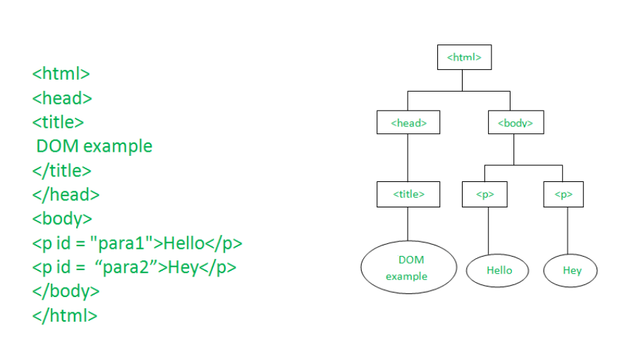
How does Javascript understand HTML document ?
When an HTML document is loaded in the browser – another representation of the same document is generated as shown:
Htmldoc JS view – DOM tree

Slide 109
HTML cannot be manipulated directly.
It can be done using DOM with the help of Javascript
The HTML DOM is a standard object model and programming interface for HTML.
It defines:
The HTML elements as objects
The properties of all HTML elements
The methods to access all HTML elements
The events for all HTML elements
In other words: The HTML DOM is a standard for how to get, change, add, or delete HTML elements.

Slide 110
DOM Manipulations
Javascript see DOM as nodes
Element Node for e.g. head
Attribute Node for e.g. id
Text Node for e.g. My title

Slide 111
Navigation between the nodes
nodeValue- innerHTML
nodeName-
parentNode
childNodes[nodenumber]
firstChild – childNodes[0]
lastChild
nextSibling
previousSibling
Eg.
document.getElementById(“p1").firstChild.nodeValue;
document.getElementById(“p1").firstChild.nodeName;

Slide 112
Javascript for dynamic html
JavaScript can change all the HTML elements in the page
JavaScript can change all the HTML attributes in the page
JavaScript can change all the CSS styles in the page
JavaScript can remove existing HTML elements and attributes
JavaScript can add new HTML elements and attributes
JavaScript can react to all existing HTML events in the page
JavaScript can create new HTML events in the page

Slide 113
Methods for manipulations
document object represents the web page.
Finding HTML Element by Id
const element=document.getElementById(“id1")
Finding HTML Element by Tag Name
const element=document.getElementsByTagName("p");
Finding HTML Elements by Class Name
const x=document.getElementsByClassName("intro");
Finding HTML Elements by CSS Selectors
const x = document.querySelectorAll("p.intro");
returns a list of all <p> elements with class="intro

Slide 114
Changing attributes…
Property | Description
element.innerHTML = new html content | Change the inner HTML of an element
element.attribute = new value | Change the attribute value of an HTML element
element.style.property = new style | Change the style of an HTML element
Method | Description
element.setAttribute(attribute, value) | Change the attribute value of an HTML element

Slide 115
Element Manipulation
document.createElement(element) | Create an HTML element
document.removeChild(element) | Remove an HTML element
document.appendChild(element) | Add an HTML element
document.replaceChild(new, old) | Replace an HTML element
document.write(text) | Write into the HTML output stream

Slide 116
Finding HTML Objects
document.anchors
document.body
document.documentElement
document.embeds
document.forms
document.head
document.images
document.links
document.scripts
document.title

Slide 117
Simple example
<html lang="en"> <head> <title>Simple example of JS in html</title> </head> <body> <p id="sample">HELLO WORLD!!! </p> </body> </html>
Change the text to “Welcome” using JS ( dynamically)

Slide 118
Modify the example
<html lang="en"> <head> <title>Simple example of JS in html</title> </head> <body> <script> document.getElementById("sample").innerHTML="WELCOME !!!"; </script> <p id="sample">HELLO WORLD!!! </p> </body> </html>
Display the URL of the document

Slide 119
Contd..
<body> <p id="sample">HELLO WORLD!!! </p> <script> document.getElementById("sample").innerHTML=document.URL; </script> </body>

Slide 120
Assignment 5.3
Identify the different ways of displaying the scripts available in the document and show in the next page of the document.
Identify the number of HTML elements in the web document
Identify the number of each type of HTML element in the document

Slide 121
DOM Events
When a user clicks the mouse – onclick, onmousedown, onmouseup, onmouseover,
When a web page has loaded - onload
When an image has been loaded - onload
When the mouse moves over an element- onmouseover
When an input field is changed – onchange, onfocus
When an HTML form is submitted- onsubmit
When a user strokes a key – onkeydown, onkeypress, onkeyup

Slide 122
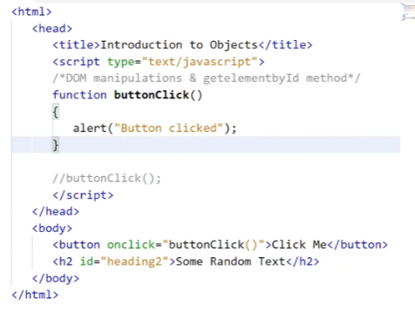

Slide 123
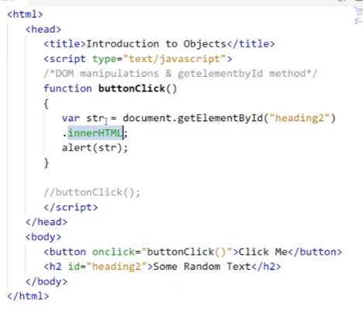

Slide 124
<!DOCTYPE html> <html lang="en"> <head> <title>Simple example of JS in html</title> <script> function welcome(name) {alert("welcome "+name);} </script> </head> <body> <form name="f1" onsubmit="welcome(document.getElementById('fname').value)"> <label for="fname"> Name:</label> <input type= "text" id = fname pattern="[A-Za-z]+" title="start with caps" required/> CLICK the button for a welcome message <input type="submit"> </form> </body> </html>

Slide 125
JavaScript is not Java
By now you should have realized that you already know a great deal of JavaScript
So far we have talked about things that are the same as in Java
JavaScript has some features that resemble features in Java:
JavaScript has Objects and primitive data types
JavaScript has qualified names; for example, document.write("Hello World");
JavaScript has Events and event handlers
Exception handling in JavaScript is almost the same as in Java
JavaScript has some features unlike anything in Java:
Variable names are untyped: the type of a variable depends on the value it is currently holding
Objects and arrays are defined in quite a different way
JavaScript has with statements and a new kind of for statement

Slide 126
Warnings
JavaScript is a big, complex language
It’s easy to get started in JavaScript, but if you need to use it heavily, plan to invest time in learning it well
Write and test your programs a little bit at a time
JavaScript is not totally platform independent
Expect different browsers to behave differently
Write and test your programs a little bit at a time
Browsers aren’t designed to report errors
Don’t expect to get any helpful error messages
Write and test your programs a little bit at a time

Slide 127
Assignment 5.4
Build a Simple To-Do List Application using HTML, CSS, JS
HTML
Create an HTML file with appropriate structure.
Include input fields for adding new tasks, a button to add tasks, and a list to display tasks.
CSS
Style your To-Do List using CSS to make it visually appealing.

Slide 128
Do one by one
JS
Implement the following functionality using JavaScript:Add tasks to the list when the user enters a task description, due date and clicks the "Add" button.
Display a validation message if the user tries to add an empty task.
Mark tasks as completed/uncompleted by clicking on them.
Delete tasks from the list.
Provide a button to clear all completed tasks.
Allow filtering tasks by "All," "Active," and "Completed" categories.
Order the tasks according to the due date.
Change the background with an image if all tasks are Completed

